Slide 1
Osnovi digitalne elektronike
2+2+1
Dr Milan Ponjavić, vanr. prof.
Dr Goran Savić, docent
http://tnt.etf.bg.ac.rs/~si2ode/
Deo diskusije sa IT formuma
“Potreban je samo jedan covek koji zna da osmisli i dokumentuje sistem do tancina, a posle 50 programera razvija software na osnovu specifikacija ovog arhitekte. Tako da je to sasvim normalno, a i nije nista IT specificno. Isto je i u masinstvu, npr u BMW-u - Chief Designer ima mnogo vecu platu od Fied Designera…”

Slide 2

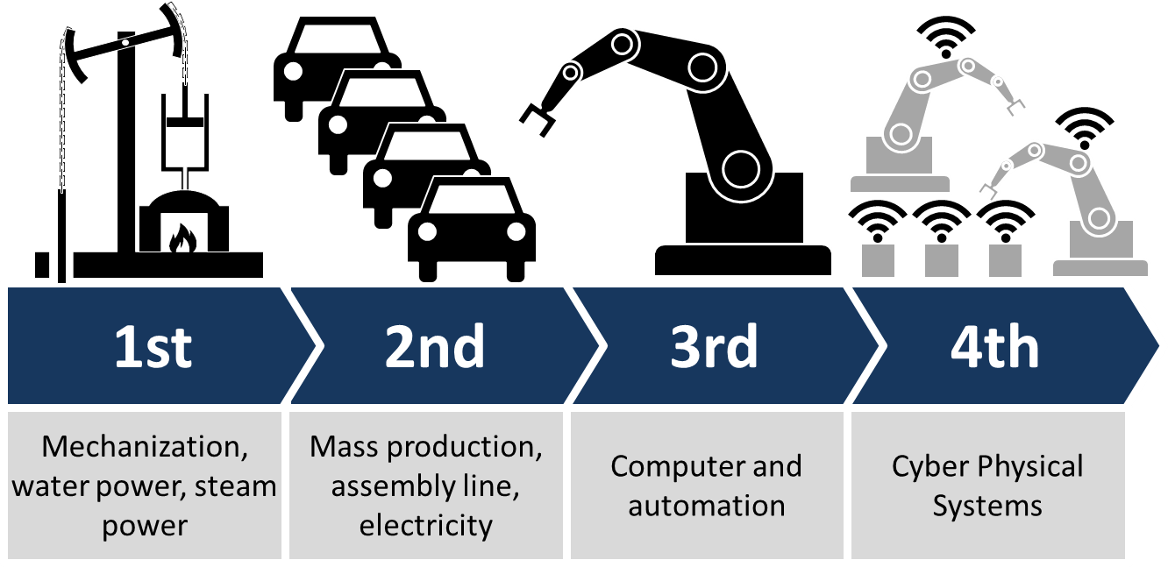
Osnovi digitalne elektronike

Slide 3
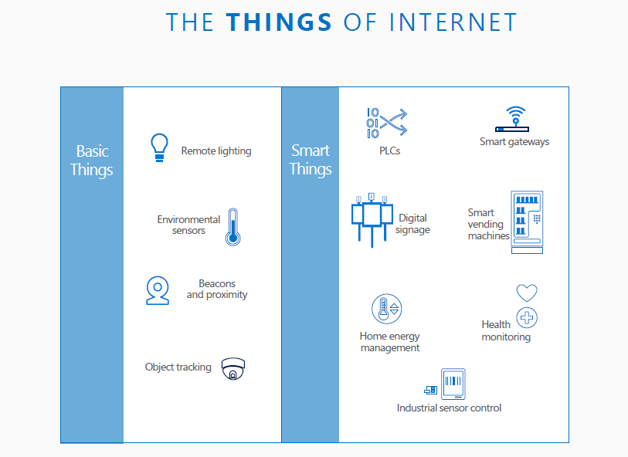
Osnovi digitalne elektronike

Slide 4
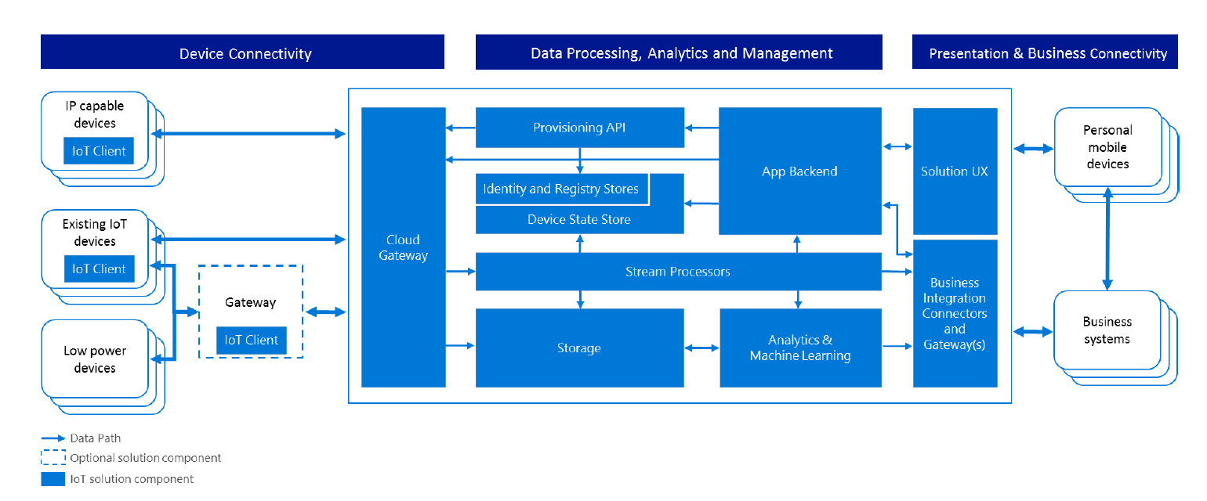
Osnovi digitalne elektronike

Slide 5
Osnovi digitalne elektronike
Embedded sistemi
Pojam iz Industry 3.0
računarski sistem sa unapred predefinisanom funkcijom unutar složenijeg elektromehaničkog sistema (suprotno računaru opšte namene)
Pored standardnih računarskih resursa postoji interakcija SW sa periferijama, senzorima i aktuatorima u sistemu ili objektu koji SW kontroliše

Slide 6
Osnovi digitalne elektronike
Hardverski orijentisani kursevi na ETF-u svrha:
formalna i akademska: ETF master diploma MSc ECE
akademska i praktična: dizajn SW+HW
praktična: dizajn računara i procesora (? ? ?)
praktična: dizajn embedded sistema (£ € $)!
…
embedded sistem + komunikacija = smart sistem
smart1+smart2+…cloud=IoT

Slide 7
Osnovi digitalne elektronike
Koncepcija upravljačkih sistema
Centralizovano merenje i kontrola
  industrijski PC
  PLC
  …
Distribuirano merenje i kontrola (M2M)
  Mreža mikrokontrolera
A microcontroller (sometimes abbreviated µC, uC or MCU) is a small computer on a single integrated circuit containing a processor core, memory, and PROGRAMMABLE input/output peripherals
Input/output peripherals: analog, digital, mix-signal

Slide 8
Sistemsko projektovanje, primer: dizajn upravljačkog sistema
A Simple Control Task: Industrial Heating
(for C2H5OH production...)
– periodically read temperature (analog input)
– turn on/off heating according to temp. (1 digital output)
– current temperature is displayed (4 digit display)
– user can adjust temp, thresholds etc with buttons
(4 bits)
– serial interface to download temp. data for last 24 h (2 bit)
● >20 digital I/O lines, timer, serial interface, etc
o
temp
C
keypad
DUS
display
On
/
Off
RS
-
232

Slide 9
DUS kao mikroprocesorski sistem

Slide 10
Digital I/O
Karakteristike grejača i povezivanje
Elektromehaničko rele, osobine, alternative
BJT u prekidačkom režimu
Kalem i kondenzator u prekidačkom režimu
Povezivanje na digitalni izlaz
Kontrola grejača preko digitalnog izlaza:

Slide 11
7 Seg displays are 8 LED's (7 segments and DP)
Basically there are two types of 7-Seg display's:
  - Common Cathode where all the segments share the same Cathode.
  - Common Anode where all Segments share the same Anode.
Svetlosna indikacija preko digitalnog izlaza:
LED dioda i LED displej
povezivanje na digitalni izlaz direktno i baferisano
povezivanje serijski

Slide 12
DIGITALNI ULAZI
taster i prekidač
normalno otvoren, normalno zatvoren
aktivno stanje logicka nula, aktivno stanje logicka jedinica
Podrhtavaje i eliminacija podrhtavanja
ANALOGNI ULAZ
Kondicioniranje signala sa senzora
Zaštita ulaza
multipleksiranje

Slide 13
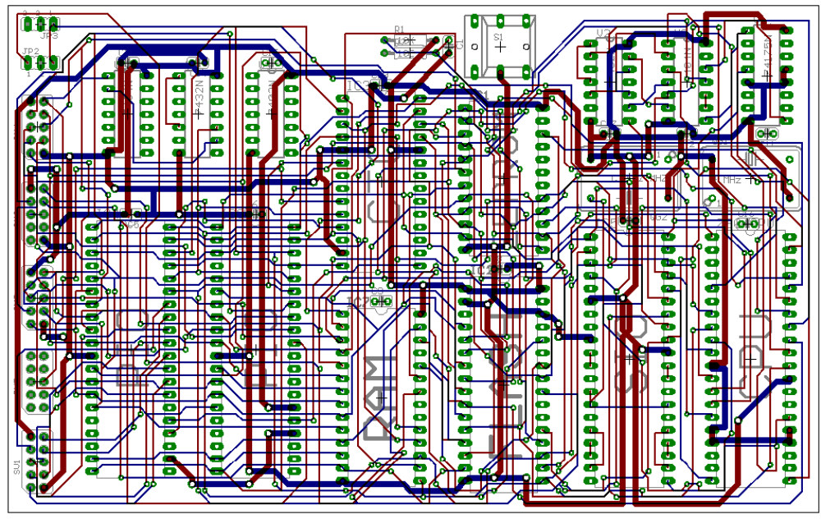
Microprocessor Implementation
– CPU 8088
– Clock generator 8284
– 4 x 74HC373 (digital I/O)
– UART (serial I/O) 8250B
– programmable timer 8254
– memory (SRAM, Flash, EEPROM)…
● requires ~10 chips (+ their connections) on PCB

Slide 14
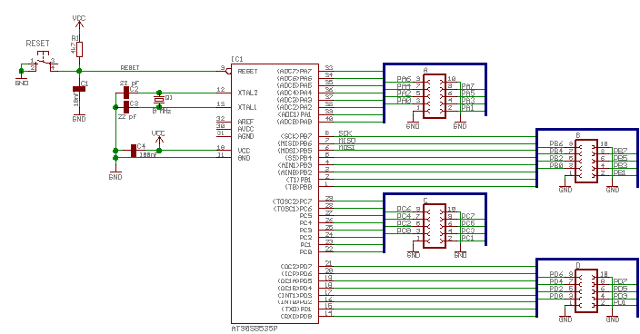
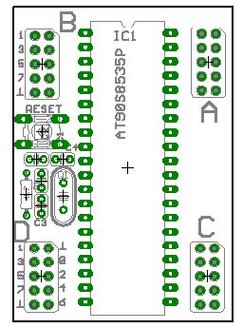
Microcontroller Implementation
Small computer on a single integrated circuit
Simple CPU
Clock generator
Timers
I/O ports
Memory (RAM+ROM+FLASH)
Optimized for interrupt driven controller applications
Extensive analog and digital I/O.
Microcontroller requirements:
– CPU
– at least 20 digital I/O lines
– serial interface
– timer
– memory: SRAM, Flash..

Slide 15
Osnovi digitalne elektronike
Microcontroller selection
Part Number |  | Cost | Notes
MSP430F2101 | TI | $1.17 | Very powerful 16 bit microcontroller, with low cost development tools, Has an on board comparator which can be used to simulate an ADC, and a software UART. This is a great part!
PIC16F630 | Microchip | $1.26 | Decent processor and easy to use tools. 14 pin packages
PIC16F676 | Microchip | $1.47 | Similar to the PIC16F630, but with ADCs.
PIC10F200 | Microchip | $0.61 | Very cheep, and very small with 8 pin SOIC and 6 pin SOT-23 packages.
AT89C2051 | Atmel | $1.05 | 20 pin package.
ATTiny11L | Atmel | $0.35 | 8 pin package. Has low cost development tools.

Slide 16
Osnovi digitalne elektronike
Logičko projektovanje i dizajn
Specification + Modeling
High-level modeling:
  Flow Charts
  FSM
  State Charts
  Data Flow
  Petri Nets
  UML
  VHDL, Verilog
  SpecC, SystemC, SystemVerilog

Slide 17
Osnovi digitalne elektronike
Logičko projektovanje i dizajn, primer: šema za obradu binarnih signala
// definicije i deklaracije
#define Ulaz P3_1
#define Izlaz1 P3_2
#define Izlaz2 P3_3
bdata char ShReg;// bit adresib.bajt
sbit Q4=ShReg^7;
sbit Q3=ShReg^6;
sbit Q2=ShReg^5;
sbit Q1=ShReg^4;
sbit Q0=ShReg^3;
bit BitA ,Tmp;
// deo C programa koji realizuje
// jedan korak pomeranja
Tmp=(BitA|Q3)&(Ulaz|Q0);
ShReg >>=1;

Slide 18
Classical automata - Finite state machines (FSM)
Provides a mathematical foundation for verifying system correctness, simulation, hardware/software partitioning, and synthesis
Specification and modeling of control dominated applications such as a real-time, reactive control systems
FSM Transducers
Transducers generate output based on a given input and/or a state using actions
Moore machine: output depends only on the state. The advantage of the Moore model is a simplification of the behavior.
Mealy machine: output depends on input and state. The use of a Mealy FSM leads often to a reduction of the number of states.

Slide 19
Coke Machine Version 1.0
  When turned on, the machine waits for money
  When a quarter is deposited, the machine waits for another quarter
  When a second quarter is deposited, the machine waits for a selection
  When the user presses “COKE,” “SPRITE” or “DIET COKE,” an appropriate item is dispensed
  When the user takes the bottle, the machine waits again
Bottles can get stuck in the machine
    An automatic indicator will notify the system when a bottle is stuck
    When this occurs, the machine will not accept any money or issue any bottles until the bottle is cleared
    When the bottle is cleared, the machine will wait for money again

Slide 21
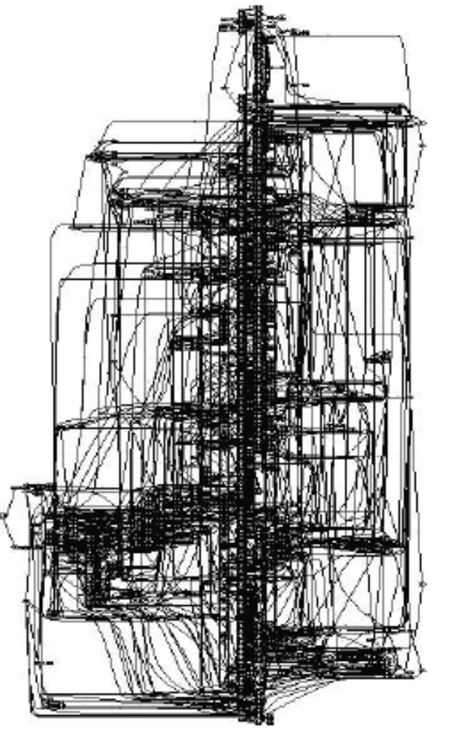
Ilustracija generisanja FSM iz flow-charta

Slide 22
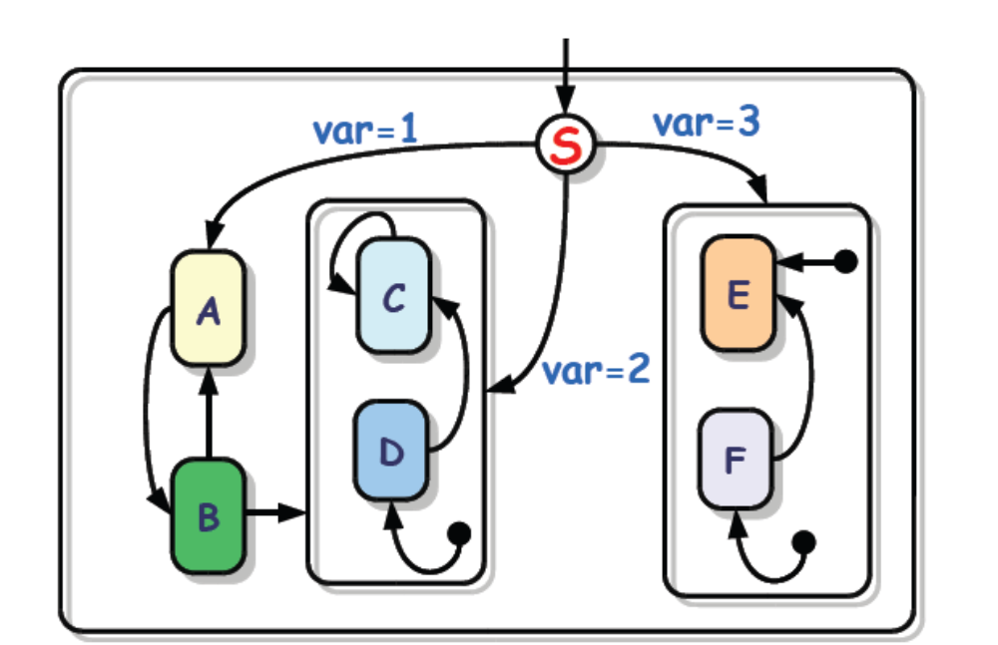
UML Statechart
  Developed by Object Management Group (OMG).
  Extend the properties of Harel’s statecharts with some new features.

Slide 24
Osnovi digitalne elektronike
Šta ćemo da radimo:
I - praktična aplikacija

Slide 25
Hardverska arhitektura
periferija
Elementarno softversko konfigurisanje i eksploatacija

Slide 26
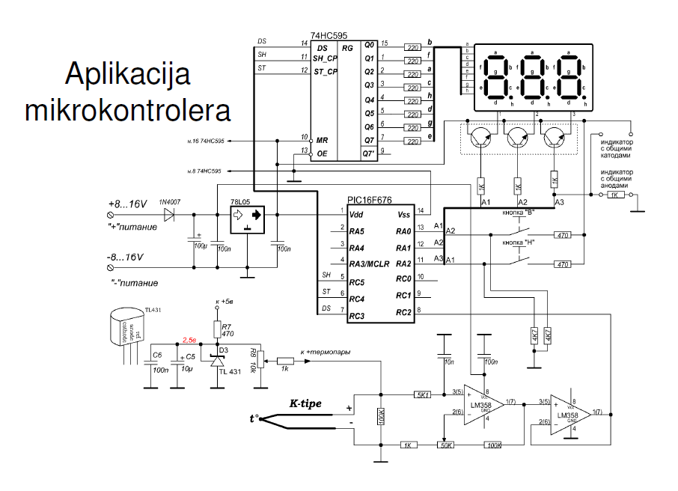
Osnovi digitalne elektronike

Slide 27
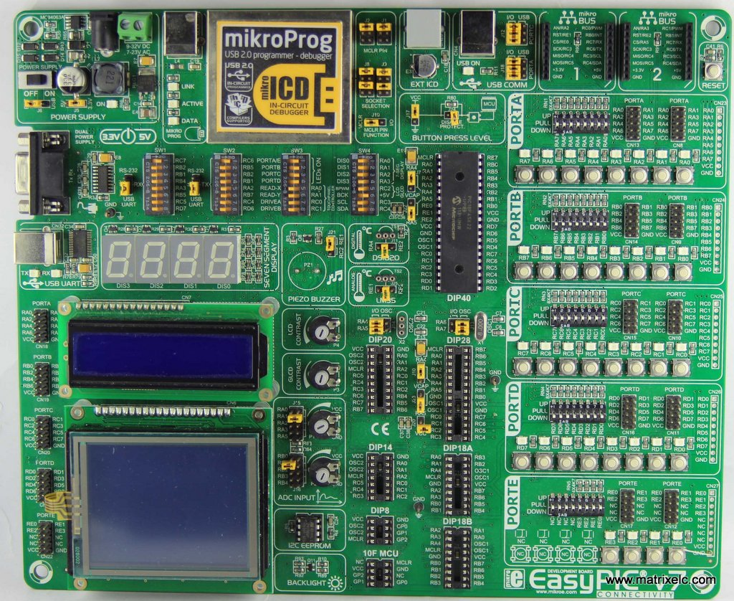
Osnovi digitalne elektronike

Slide 28
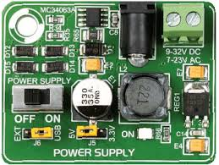
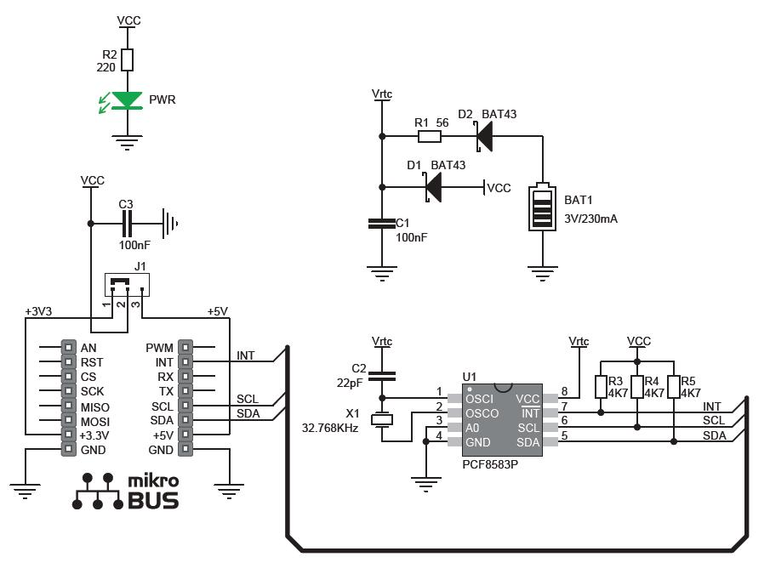
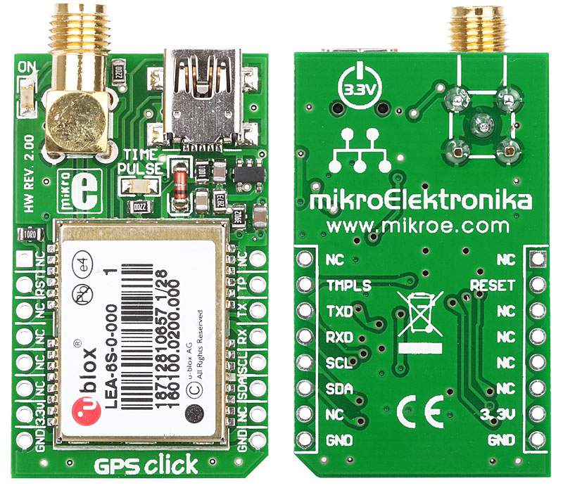
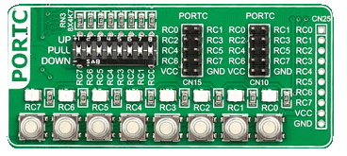

Slide 29
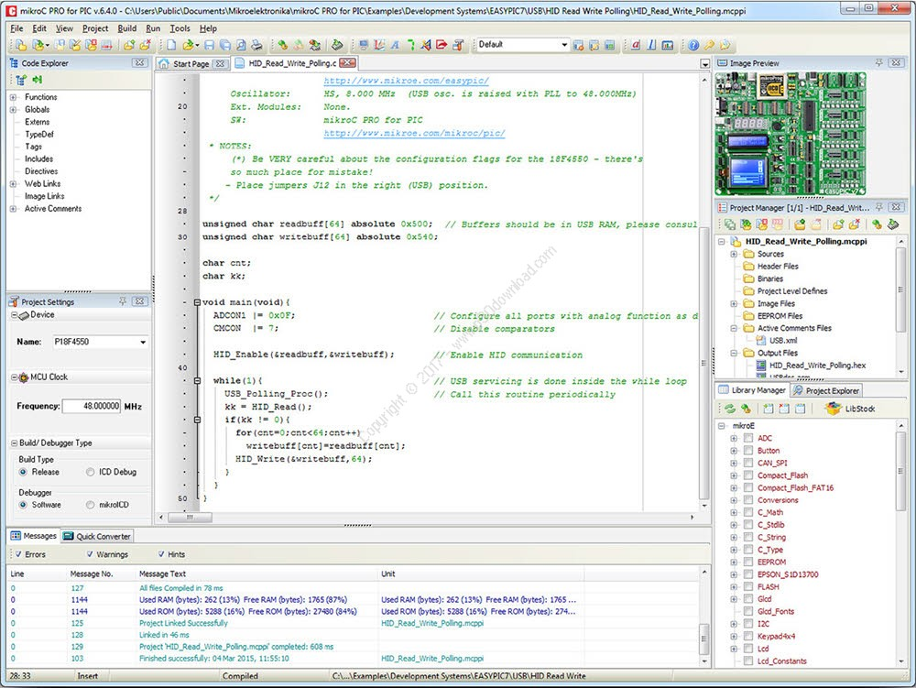

Slide 31
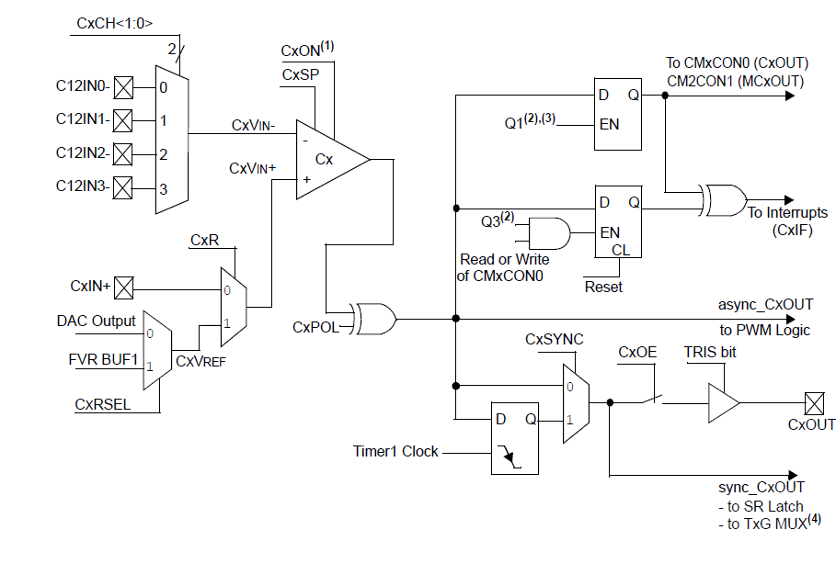
MCU HARDWARE RESOURCES
Comparator
-Input signal MUX
+Input signal MUX

