Slide 1


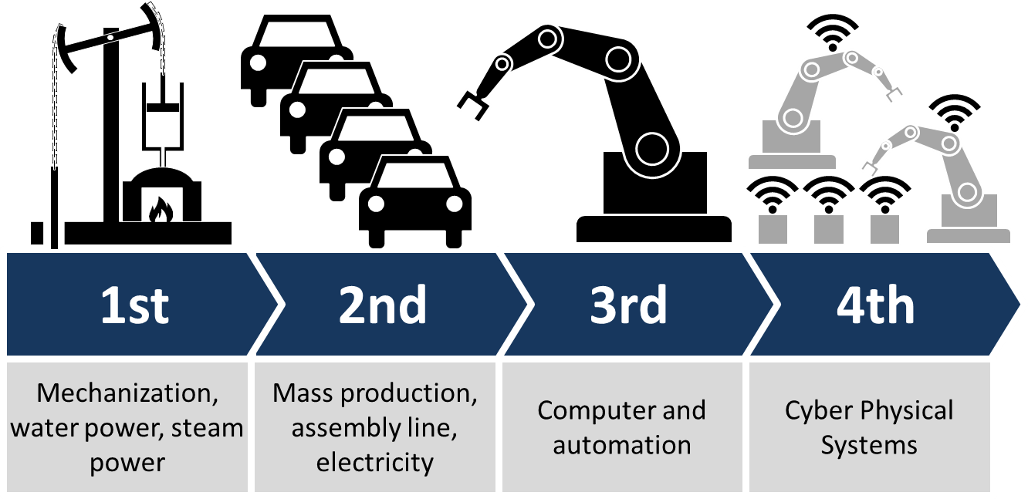
Osnovi digitalne elektronike

Slide 2
Osnovi digitalne elektronike
Humanity is facing the biggest challenge of its existence. The proposed strategy in INDUSTRY 4.0, is where the physical world merges with the virtual. Information technology, telecommunications and manufacturing are united when the means of production are becoming more independent. It is still impossible to say how smart factories will look in the future. The scientists from around the world, from all scientific fields are called to seek an answer to the many challenges of INDUSTRY 4.0.

Slide 3

Osnovi digitalne elektronike

Slide 4
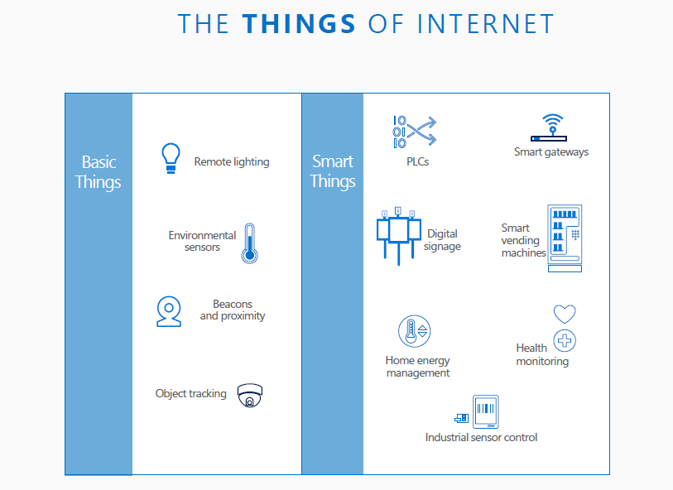
Osnovi digitalne elektronike

Slide 5

Osnovi digitalne elektronike

Slide 6
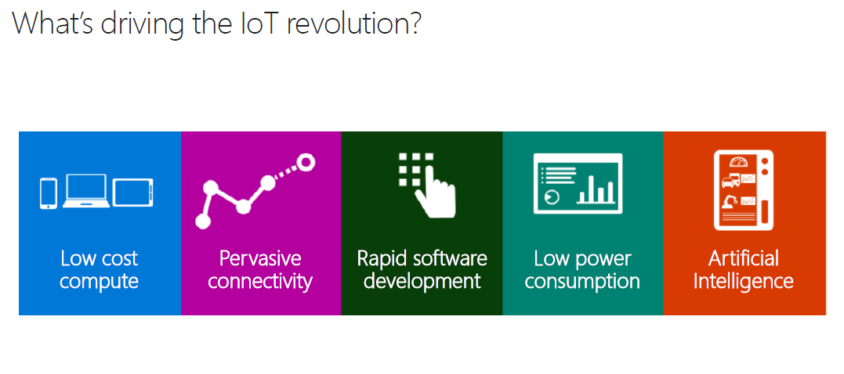
Osnovi digitalne elektronike

Slide 7
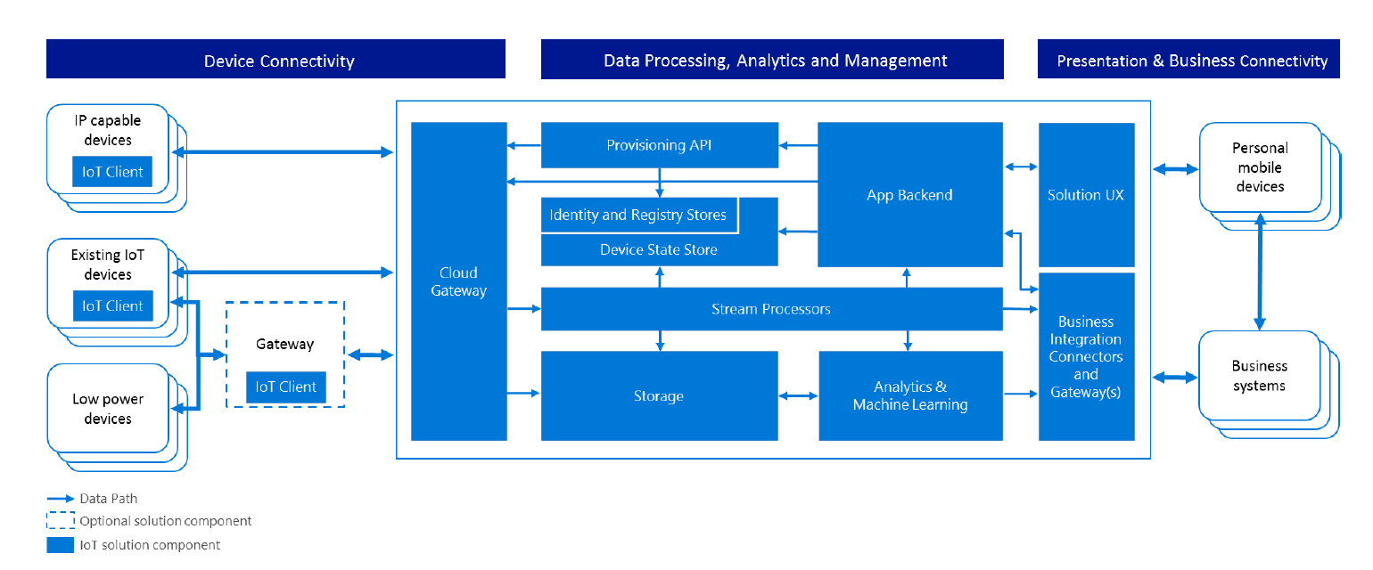
Osnovi digitalne elektronike

Slide 8
Osnovi digitalne elektronike
Embedded sistemi
Embedded system je računarski sistem sa unapred predefinisanom funkcijom unutar složenijeg elektromehaničkog sistema (suprotno računaru opšte namene)
Pored standardnih računarskih resursa postoji interakcija SW sa periferijama, senzorima i aktuatorima u sistemu ili objektu koji SW kontroliše

Slide 9
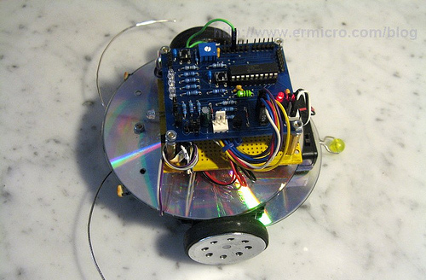
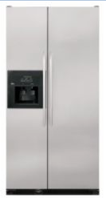
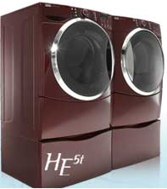
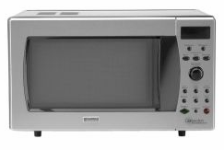
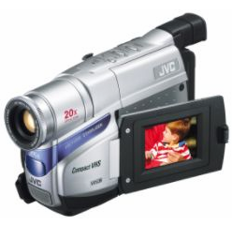
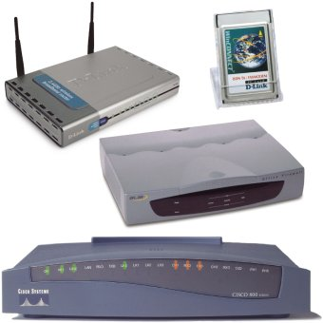
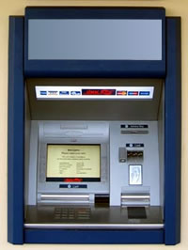
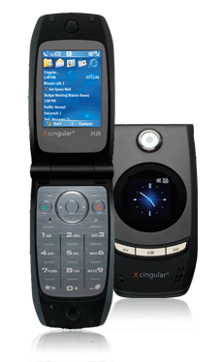


Slide 10
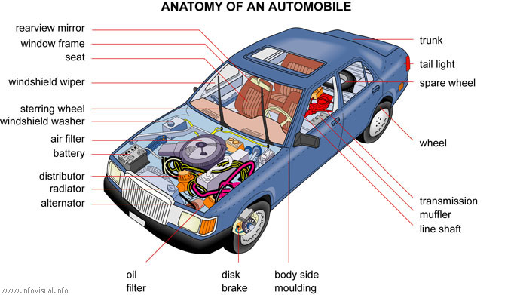
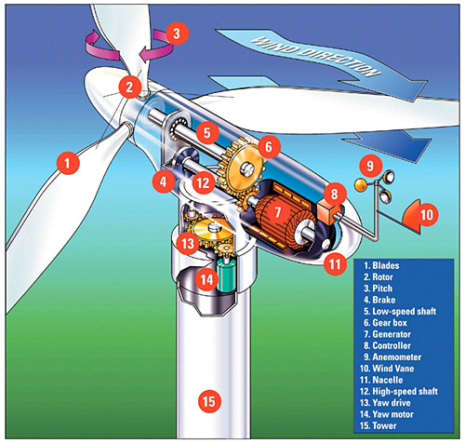
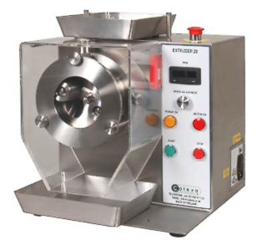
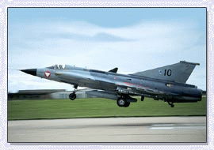

Slide 11
Šema za obradu binarnih signala
// definicije i deklaracije
#define Ulaz P3_1
#define Izlaz1 P3_2
#define Izlaz2 P3_3
bdata char ShReg;// bit adresib. bajt
sbit Q4=ShReg^7;
sbit Q3=ShReg^6;
sbit Q2=ShReg^5;
sbit Q1=ShReg^4;
sbit Q0=ShReg^3;
bit BitA ,Tmp;
// deo C programa koji realizuje
// jedan korak pomeranja
Tmp=(BitA|Q3)&(Ulaz|Q0);
ShReg >>=1;

Slide 12
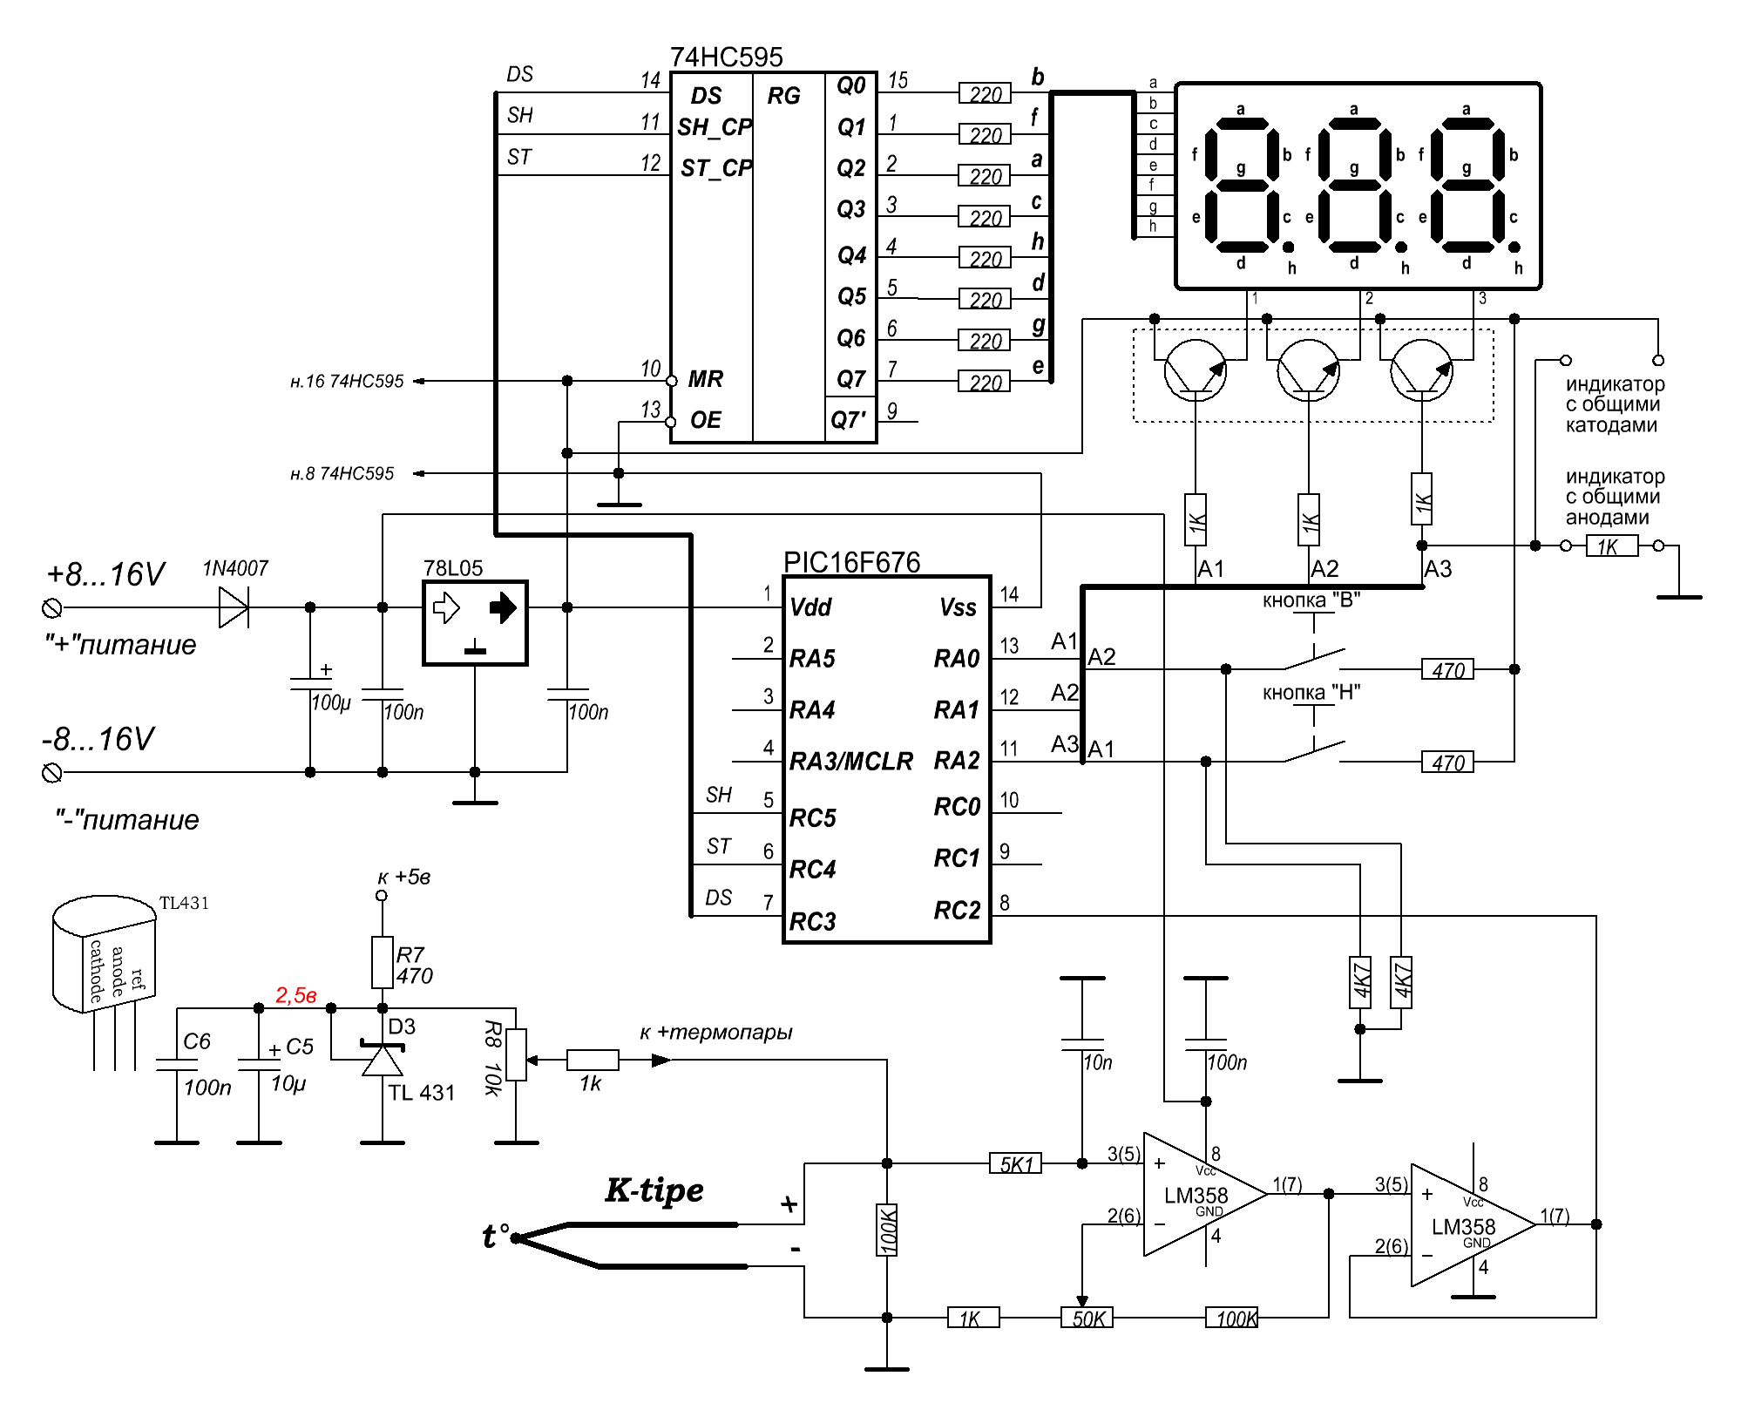
Osnovi digitalne elektronike

Slide 13
Osnovi digitalne elektronike

Slide 14
Osnovi digitalne elektronike
Part Number |  | Cost | Notes
MSP430F2101 | TI | $1.17 | Very powerful 16 bit microcontroller, with low cost development tools, Has an on board comparator which can be used to simulate an ADC, and a software UART. This is a great part!
PIC16F630 | Microchip | $1.26 | Decent processor and easy to use tools. 14 pin packages
PIC16F676 | Microchip | $1.47 | Similar to the PIC16F630, but with ADCs.
PIC10F200 | Microchip | $0.61 | Very cheep, and very small with 8 pin SOIC and 6 pin SOT-23 packages.
AT89C2051 | Atmel | $1.05 | 20 pin package.
ATTiny11L | Atmel | $0.35 | 8 pin package. Has low cost development tools.

Slide 16
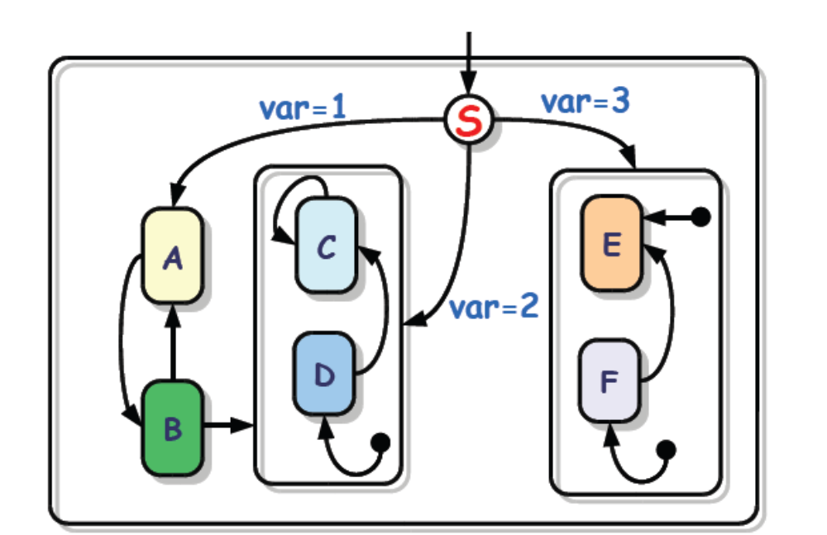
UML Statechart
  Developed by Object Management Group (OMG).
  Extend the properties of Harel’s statecharts with some new features.

Slide 18
Hardverski orijentisani kursevi na SI
I godina
  OE1
  ORT1
II godina
  ORT2
  ODE
  SI2AR
III godina
SI3AR1
SI3AR2
IV godina
SI4MS
SI4VLS
SI4MPS
Si4PAR

Slide 21
Deo diskusije sa IT formuma
“Potreban je samo jedan covek koji zna da osmisli i dokumentuje system do tancina, a posle 50 programera razvija software na osnovu specifikacija ovog arhitekte. Tako da je to sasvim normalno, a i nije nista IT specificno. Isto je i u masinstvu, npr u BMW-u - Chief Designer ima mnogo vecu platu od Fied Designera…”

